Slide 1
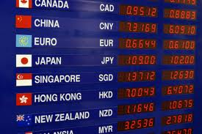
Exchange Rate Calculator Task 2
Sander van Zuidam
Stefan Smits
Boy Lenssen
Rolf Janssen

Slide 2
Requirements
Backwards compatible
Support multiple exchange rates in one calculator
Merge two calculators

Slide 3
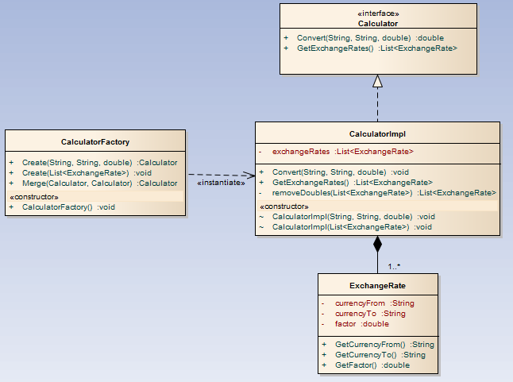
Class diagram

Slide 4
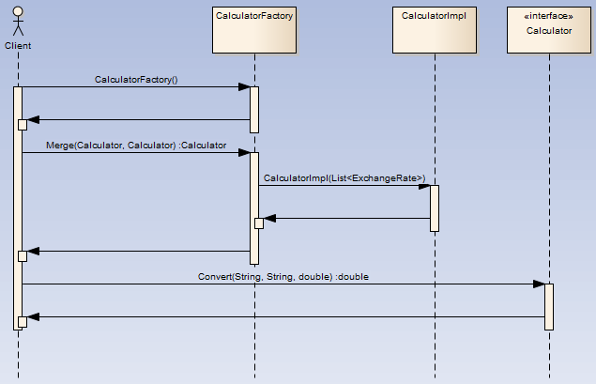
Merge

Slide 5
Questions?

